Slide 1
Java Collections

Slide 2
Introduction
“Provides a well-designed set of interfaces and classes for storing and manipulating groups of data as a single unit, a collection”
Convenient API to many od data structures: maps, sets, lists, trees, arrays, hashtables, and other collections

Slide 3
Introduction
The Java classes in the Collections Framework encapsulate both the data structures and the algorithms associated with these abstractions.
Offers altering, querying and providing alternative views methods
Offers efficient algorithms
Offers Interoperability

Slide 4
Generics in java
Java Generics are a language feature that allows for definition and use of generic types and methods.”
BaseType <Type> obj = new BaseType <Type>()
class Test<T>
{
// An object of type T is declared
T obj;
Test(T obj) { this.obj = obj; } // constructor
public T getObject() { return this.obj; }
}

Slide 5
Interface Hierarchy
The Collection interface is a group of objects, with duplicates allowed.
The Set interface extends Collection but forbids duplicates.
The List interface extends Collection, allows duplicates, and introduces positional indexing.
The Map interface extends neither Set nor Collection.

Slide 6
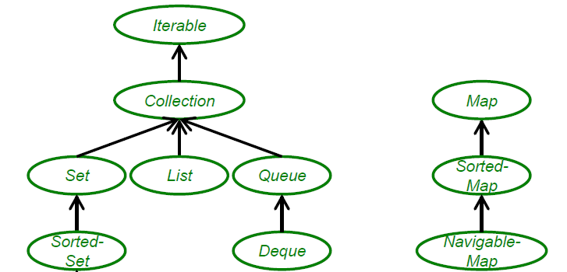
Overview of Interfaces

Slide 7
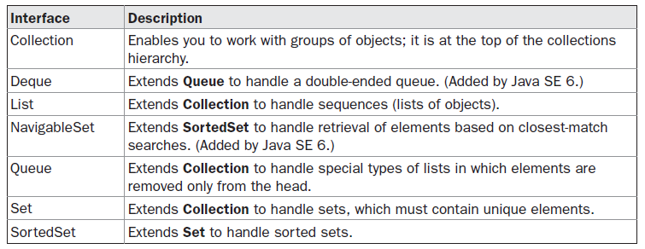
Collection Interfaces
Also Uses Comparator, RandomAccess, Iterator, and ListIterator interfaces

Slide 8
Collection Interface
Used to represent any group of objects, or elements
inteface Collection<E>
List of public methods:
can throw an UnsupportedOperationException.
AClassCastException is generated when one object is incompatible with another

Slide 9
Collection Interface
boolean add(E obj)
boolean addAll(Collection<? extends E> c)
void clear( )
boolean contains(Object obj)
boolean containsAll(Collection<?> c)
boolean equals(Object obj)
int hashCode( )
boolean isEmpty( )
Iterator<E> iterator( )
boolean remove(Object obj)
boolean removeAll(Collection<?> c)
boolean retainAll(Collection<?> c)
int size( )
Object[ ] toArray( ) <T>
T[ ] toArray(T array[ ])

Slide 10
List Interface
The List interface extends the Collection interface to define an ordered collection, permitting duplicates.
The interface adds position-oriented operations.
Interface List<E>
void add(int index, E obj)
boolean addAll(int index,
Collection<? extends E> c)
E get(int index)
int indexOf(Object obj)
int lastIndexOf(Object obj)
ListIterator<E> listIterator( )
ListIterator<E> listIterator(int index)
E set(int index, E obj)
List<E> subList(int start, int end)

Slide 11
Set Interface
Extends the Collection interface
interface Set<E>
Forbids duplicates within the collection
Attempt to add duplicate element will be ignored
No new methods are introduced
Two sets are equal if they are the same size and contain the same elements
No internal ordering matters
The hash code for a set is the sum of the hash codes for the elements of the set

Slide 12
SortedSet Interface
Maintains elements in sorted order
interface SortedSet<E>
Comparator<? super E> comparator( )
E first( )
SortedSet<E> headSet(E end)
E last( )
SortedSet<E> subSet(E start, E end)
SortedSet<E> tailSet(E start)

Slide 13
Queue & Deque Interface
interface Queue<E>
interface Deque<E>
offers double ended queue
E element( )
boolean offer(E obj)
E peek( )
E poll( )
E remove( )

Slide 14
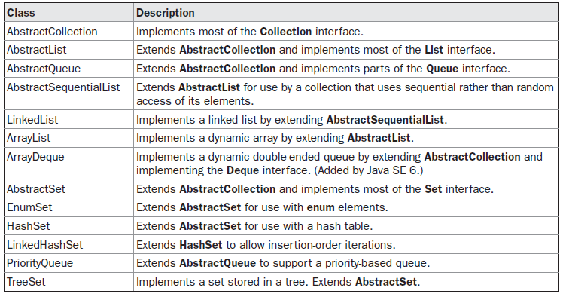
Concrete Collection Classes
Each interface type is implemented by one or more classes

Slide 15
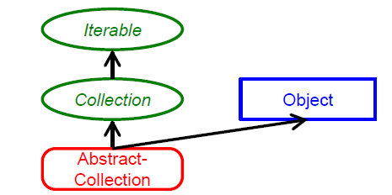

Slide 16
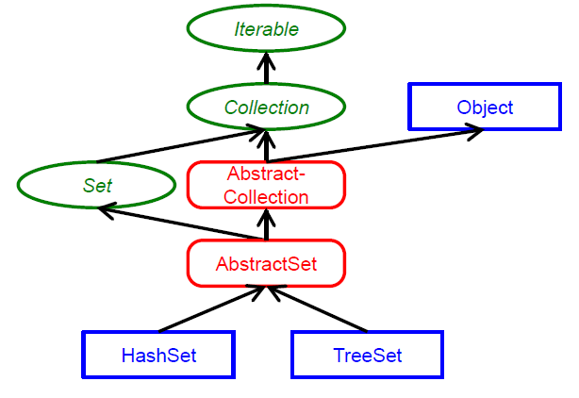
Overview of Set Classes

Slide 17
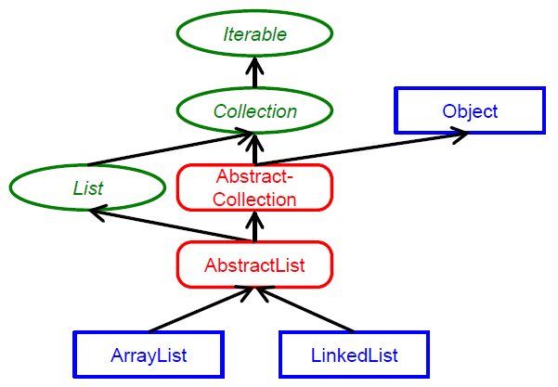
Overview of List Classes

Slide 18
ArrayList
ArrayList
class ArrayList<E>
Uses concept of dynamic array
Support random Access
Insert and remove happens
Constructor
ArrayList( )
ArrayList(Collection<? extends E> c)
ArrayList(int capacity)

Slide 19
LinkedList
LinkedList
class LinkedList<E>
Offers doubly linked list
Sequential access is allowed
Add or remove in the middle of the list
Adds several methods for working with the elements at the ends of the list
Constructor
LinkedList( )
LinkedList(Collection<? extends E> c)

Slide 20
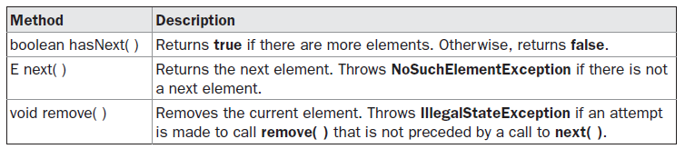
Iterator Interface
Can traverse a collection from start to finish and safely remove or add elements from or to the underlying Collection
Each of the collection classes provides an iterator( ) method that returns an iterator to the start of the collection.

Slide 21
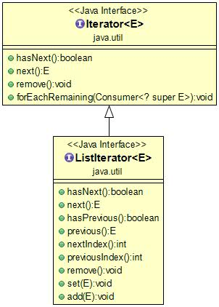
ListIterator Interface
Extends Iterator interface

Slide 22
Exercise
Suppose the list letters contains elements "A", "B", "C", and "D". Draw the contents of the list and the iterator position for the following operations:
ListIterator<String> iter = letters.iterator();
iter.next();
iter.next();
iter.remove();
iter.next();
iter.add("E");
iter.next();
iter.add("F");

Slide 23
HashSet Class
class HashSet<E>
Constructor:
HashSet( )
HashSet(Collection<? extends E> c)
HashSet(int capacity)
HashSet(int capacity, float fillRatio)

Slide 24
TreeSet
class TreeSet<E>
Uses tree for storage
Objects are stored in sorted, ascending order
Constructor:
TreeSet( )
TreeSet(Collection<? extends E> c)
TreeSet(Comparator<? super E> comp)
TreeSet(SortedSet<E> ss)

Slide 25
Map Interface
Not an extension of the Collection interface.
maintain key-value associations.
No duplicate key exists.
Don’t implement the Iterable interface
Cannot use for-each style loop
Can’t obtain an iterator to the map

Slide 26
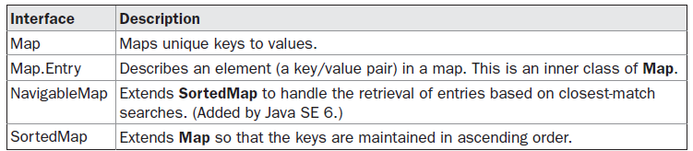
Map Interfaces
interface Map<K, V>

Slide 27
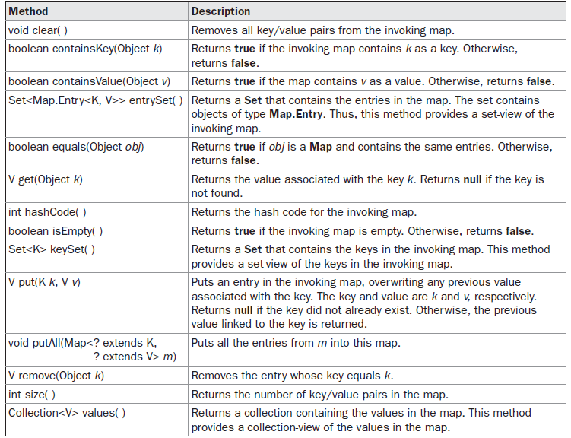
Map Interface methods

Slide 28
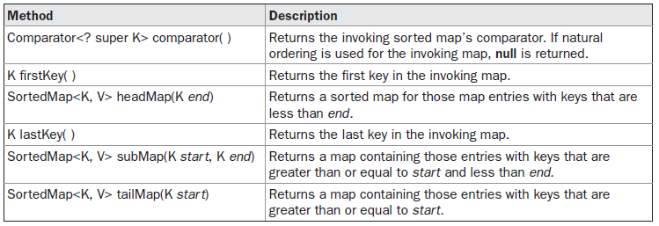
SortedMap Interface
It ensures that the entries are maintained in ascending order based on the keys.
interface SortedMap<K,V>

Slide 29
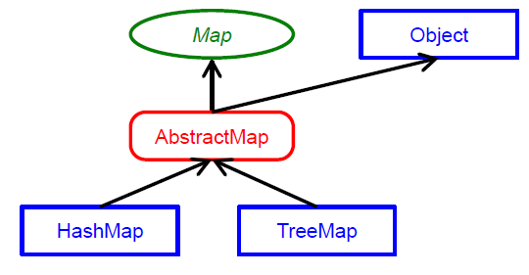
Overview of Map Classes

Slide 30
HashMap and TreeMap
HashMap
Insertion, deletion and locating an element perform better
TreeMap
Traversing in a sorted order performs better

Slide 31
Comparable and comparator Interface
Comparable
Class has natural ordering
compareTo()
Comparator
User can defined own comparable
compare()
equals()

Slide 32
Comparator Interface
Defines meaning of sorted order
By default “natural ordering”
interface Comparator<T>
Two Methods:
int compare(T obj1, Tobj2)
boolean equals(Object obj)

Slide 33
Collections class
To prevent the accidental modification of the collection
provides six factory methods:
* Collection unmodifiableCollection(Collection collection)
* List unmodifiableList(List list)
* Map unmodifiableMap(Map map)
* Set unmodifiableSet(Set set)
* SortedMap unmodifiableSortedMap(SortedMap map)
* SortedSet unmodifiableSortedSet(SortedSet set)

Slide 34
Collections class
provides for the ability to wrap existing collections into synchronized ones
provides six factory methods:
* Collection synchronizedCollection(Collection collection)
* List synchronizedList(List list)
* Map synchronizedMap(Map map)
* Set synchronizedSet(Set set)
* SortedMap synchronizedSortedMap(SortedMap map)
* SortedSet synchronizedSortedSet(SortedSet set)

Slide 35
Legacy Classes
The following are the legacy classes defined by java.util package
Dictionary
HashTable
Properties
Stack
Vector
Defined before Collection framework
All the legacy classes are synchronized
There is only one legacy interface called Enumeration

Slide 36
Properties Class
Properties class extends Hashtable class.
It is used to maintain list of value in which both key and value are String
One advantage of Properties over Hashtable is that we can specify a default property that will be useful when no value is associated with a certain key.

Slide 37
Arrays Class
The Arrays class in java.util package is a part of the Java Collection Framework.
This class provides static methods to dynamically create and access Java arrays.
It consists of only static methods and the methods of Object class.
Offers operations on array like sorting, searching and filling elements

Slide 38
Exercise
1.A gradebook application stores a collection of quizzes. Should it use a list or a set?
2. A student information system stores a collection of student records for a university. Should it use a list or a set?
3. Why is a queue of books a better choice than a stack for organizing your required reading?
4. As you can see from Figure 1, the Java collections framework does not consider a map a collection. Give a reason for this decision.

